Slide 1

Web scraping
Meet Sheth(19DCE134)

Slide 2
What is web scraping?
Web harvesting or web data extraction is data scraping
Used for extracting data from
Directly access the World Wide Web using the Hypertext Transfer Protocol or a web browser

Slide 3
How is it done
Get html.
Parse html
Traversal html

Slide 4
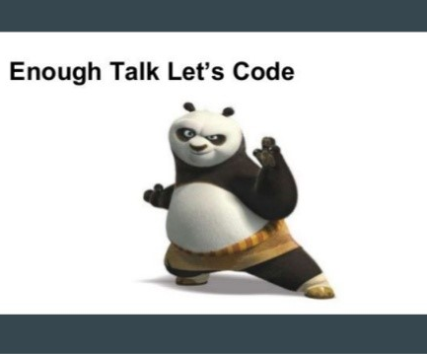
Let’s go to the vedio……

Slide 5
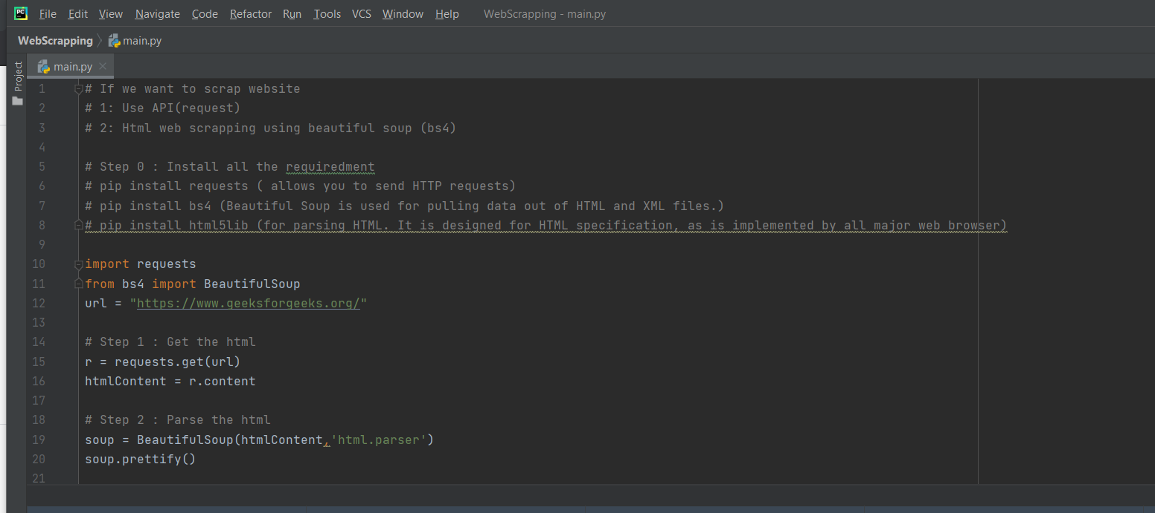
SOME CODE

Slide 6
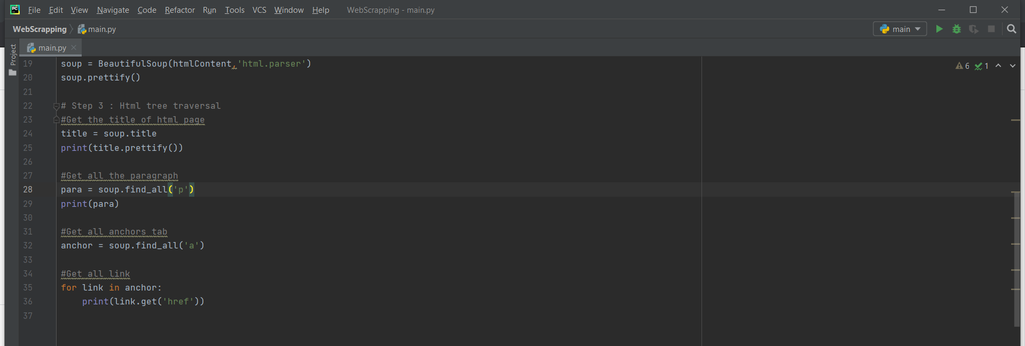
SOME CODE

Slide 7
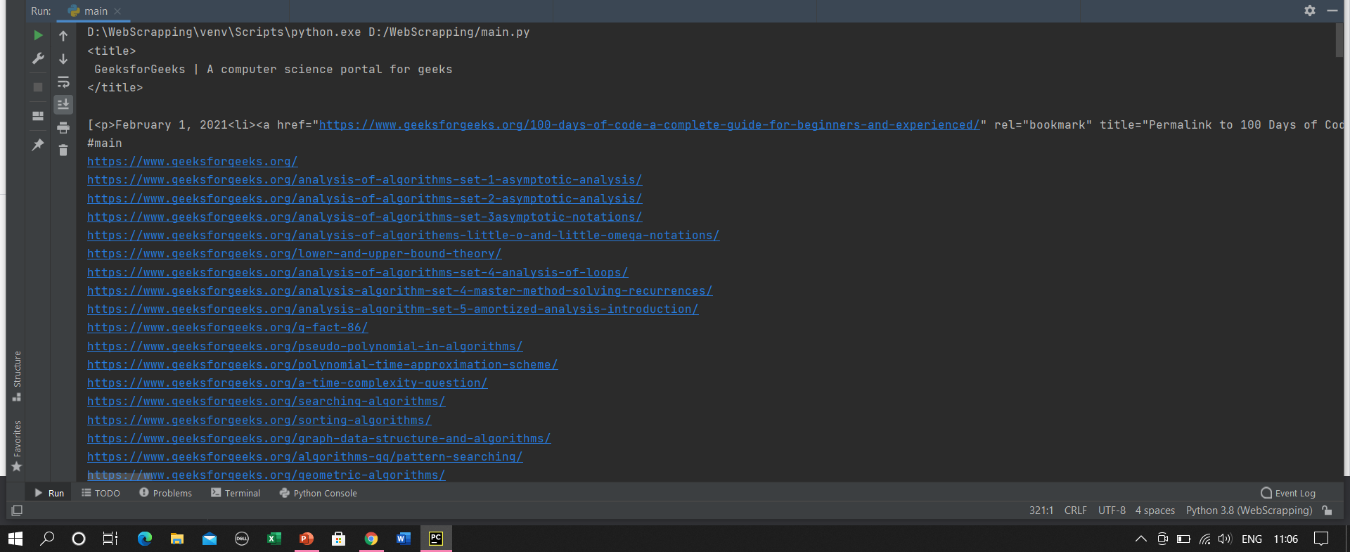
OUTPUT

Slide 8
Reference
https://youtu.be/uufDGjTuq34

Slide 9
Thank you

